Slide 1

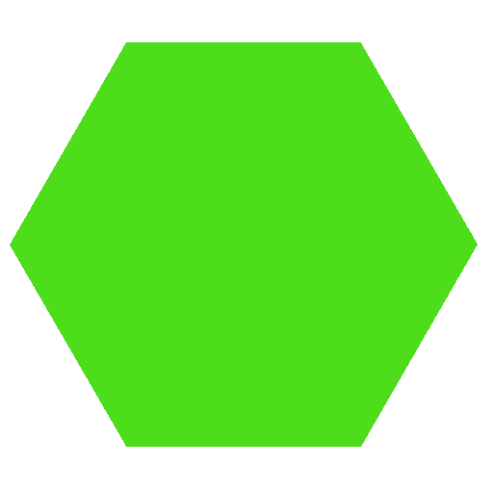
What is a polygon?
Notes:
The teacher should ask first to students if they know what is a polygon. From there the activity should start.

Slide 2
Identify polygons?
Notes:
The teacher should give to each student the “Identify polygons” worksheet and let them do the work

Slide 3
Tessellations
Notes:
The teacher should now introduce the concept of tessellation

Slide 4
Identify Regular Tessellations
Notes:
The teacher should give to each student the “Identify Regular Tessellations” worksheet and let them do the work

Slide 5
Identify SemiRegular Tessellations
Notes:
The teacher should give to each student the “Identify SemiRegular Tessellations” worksheet and let them do the work

Slide 6
Build your own tessellation
Notes:
The teacher should give to each student the “Build your own Tessellation” worksheet and invite students to use the plastic pieces to make there own tessellations

Slide 7
“Calçada Portuguesa” – a brief history

Slide 8
There is a city in the world that is unique by all the tessellations that existed in the streets.
Lisbon, in Portugal is that city.

Slide 9
In general it’s made with white and black limestone. In the begin of the nineteenth century the streets begin to have this type of floor.
Here you can find:

Slide 10
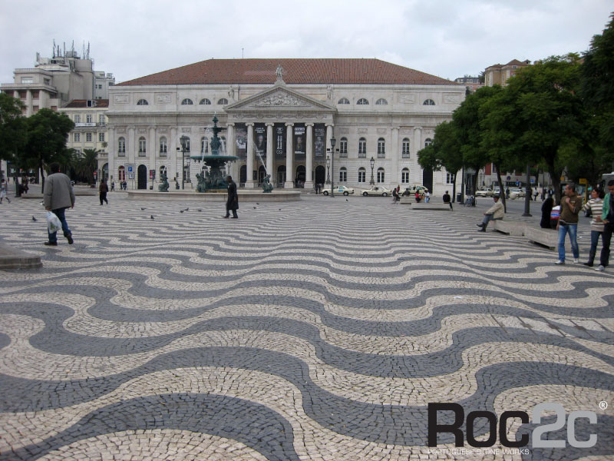

Slide 11
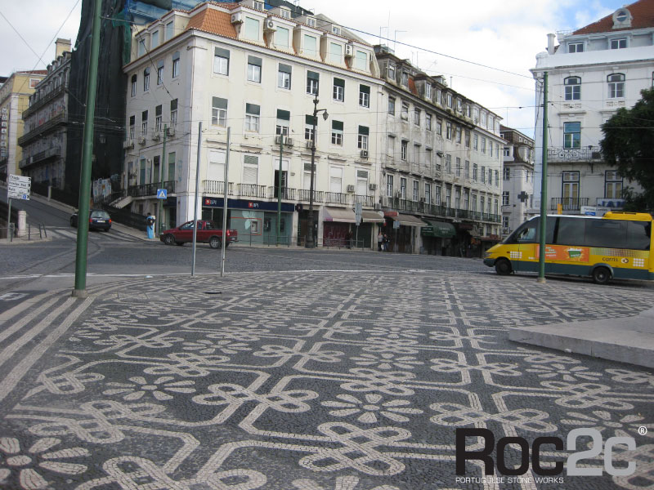

Slide 12
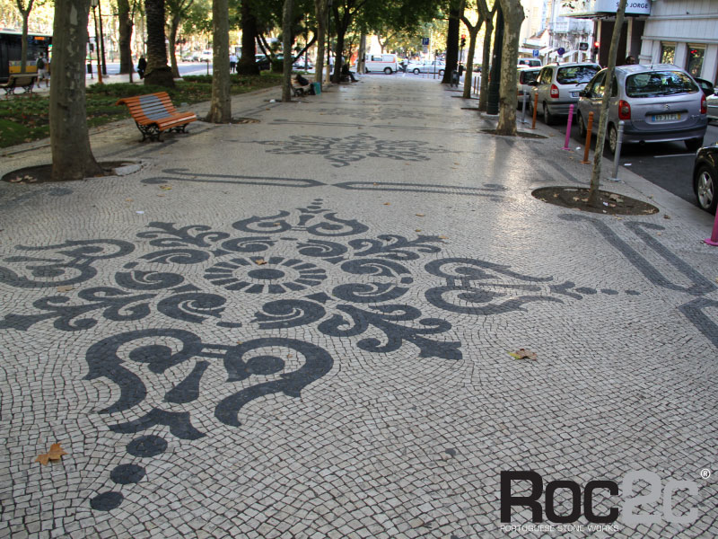

Slide 13
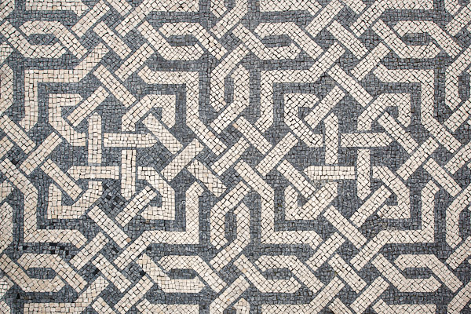
Photo Credit by João Ferrand

Slide 14
This are only a few of them. The important here is to show that math is all around in our lives and the use of math can produce beautiful things.

