Slide 1

Project: SUPER FOOT
Team Name : SMART SAMARITANS
Project Associates
Ch. Anand Anoop
V. Rajesh kumar
Ch. Sai Krishna
S Arul Frances

Slide 2
HOW THE IDEA STARTED?
We felt really very sorry for our Colleague, whose legs are disabled very badly and she struggles a lot daily with crutches to walk. Though there is provision for lift, it is harder for her to reach that distance even .So, we got a thought to make the life of her and much more people like her a stress free and fruitful one.

Slide 3
THE IDEA
It is the idea of creating wirelessly controllable motorized boots for the physically challenged (leg) that can be used with ease and can be worn throughout the day.
These boots can be used without any discomfort over any kind of shoes of almost all sizes or over prosthetic legs. With which they can move around by standing to their height and can sit on chairs, sofas as we do with no or less help of others.

Slide 4
WORKING AND IMPLEMENTATION
The aid will consist of a pair of low weight wearable boots, motorized wheels, a battery pack, a back strap for support and a compact motorized unit. The motion and the direction of the wheels can be controlled by the mechanism used inside the boots.

Slide 5
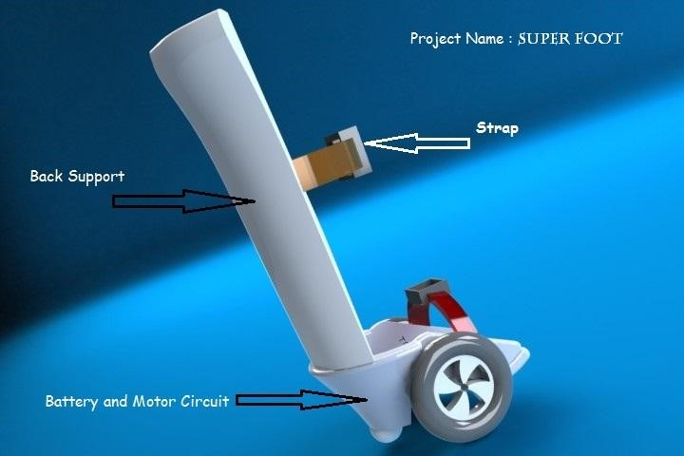
Proposed Design (Rendered Prototype) -Dimensions are not to Scale
Iteration 1

Slide 6
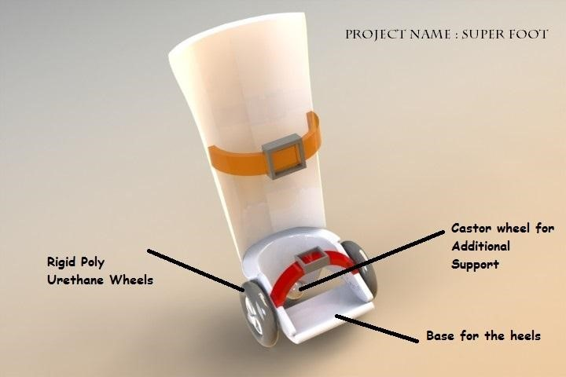
Iteration 1 of Our Design

Slide 7
Difference Between Iteration 1 and Iteration 2
Modification No | Iteration 1 | Iteration 2
1 | Weight is more since used 2 motors per shoe | Weight reduction is made by using a compact power single motor per shoe
2 | 2 Wheels were used for the Motion but less turnability and stability | 1 Wheel connected to a Motor Drive and a Caster wheel for the better stability and turnability
3 | Using a battery pack made of Li Ion Battery which is not safe and very heavy | Finalised to use LiFePO4(Lithium Iron phosphate) Cells as a pack for higher battery back up, less discharge at idle time and Very Safe

Slide 8
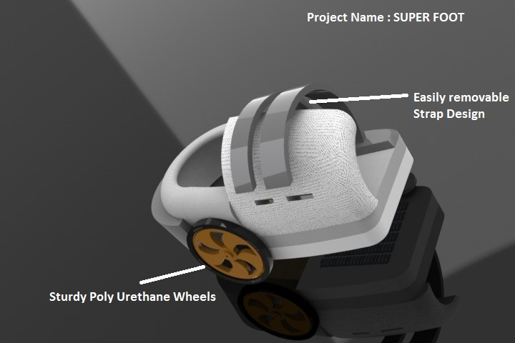
Our Iteration 2 Design with better improvement (Shown only the Base part, the Back Support will be same as Iteration 1 Design)

Slide 9
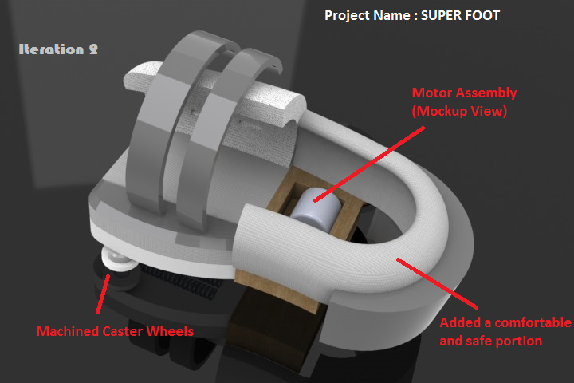
Top View ( Iteration 2)

Slide 10
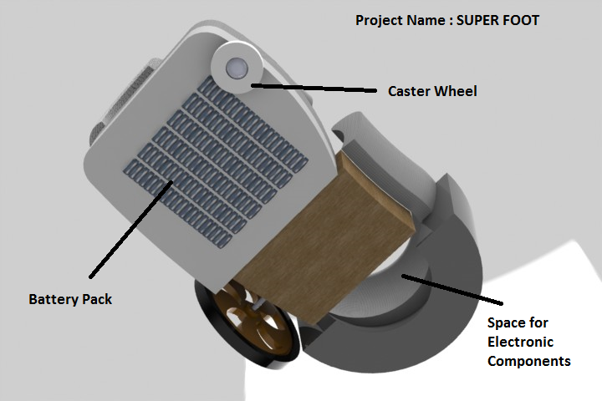
Base Part

Slide 11
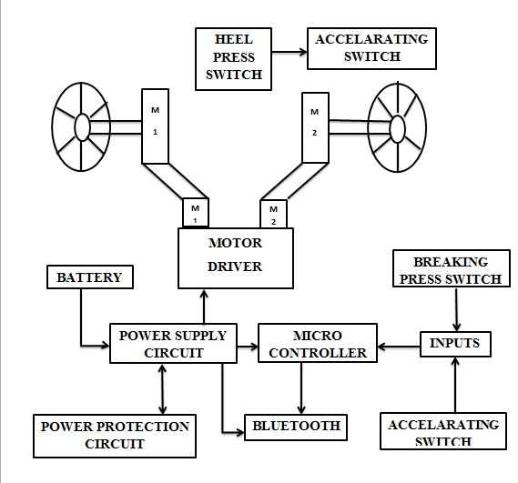
How it Works!

Slide 12
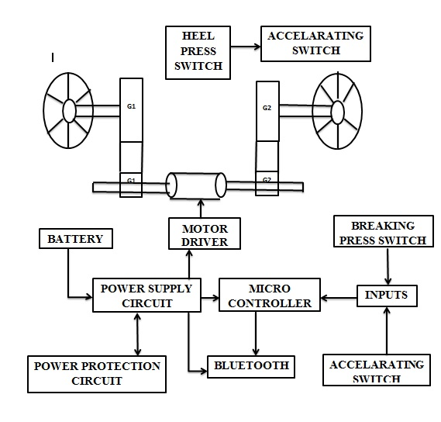

Slide 13
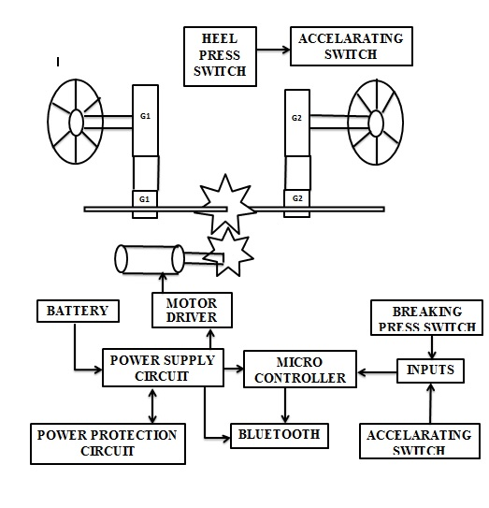

Slide 14
Components Used:
High Sturdy carbon fiber boots
Bi shaft Brushless DC Motor with a planetary gear Box
  Torque -150 (approx.), Power Rating (12 V, 60 Amps) with necessary Heat Sink.
Custom made Arduino Boards
Battery
  Lithium Polymer Battery (12 V, 60 Amps)
Transmitter & Receiver Circuit
  Micro Controller Atmega 32
  Radio Transmitter & Receiver 375 MHz
  Power conversion Circuit for step downing voltage to 5V and current to milliamps

Slide 15
Wheels
  Made of Poly Urethane with additional enhancements for improved grip
  Castor wheels made of strong alloy for stability and for multidirectional movement
Motor Specification
DC Brushless Hub Motor,
200 Rpm,
150 Kg-cm Torque,
24 Volts,
60 Amperes

Slide 16
Motor Ratings
WEIGHT : 490 GMS
RPM : 200 at 12V
TORQUE : 150 KG-CM at 60 AMPS
GEAR RATIO : 1:64
DRIVE SHAFT DIAMETER: 12.7MM
SHAFT LENGTH : 38MM
SHAFT FITTING : 3MM KEY SLOT

Slide 17
MOTOR DRIVER
Super Hercules 9v-24v,15amps(motor driver)
This motor drive can take up to 30amps peak current load and can be operated up to10khz.
It also gives out fault diagnostics output and overload protection limit.
It can take up to 10amps current continuously at 27oc ambient temperature without any need for external cooling.

Slide 18
Key Features on Motor Parts Used
Output current
- 10A w/o any cooling
- 15A with small air flow
30A with adequate cooling
80A with excellent cooling
Under voltage shut down
Over load protection
Fault diagnostics output
size: 50.1mm*75.7mm

Slide 19
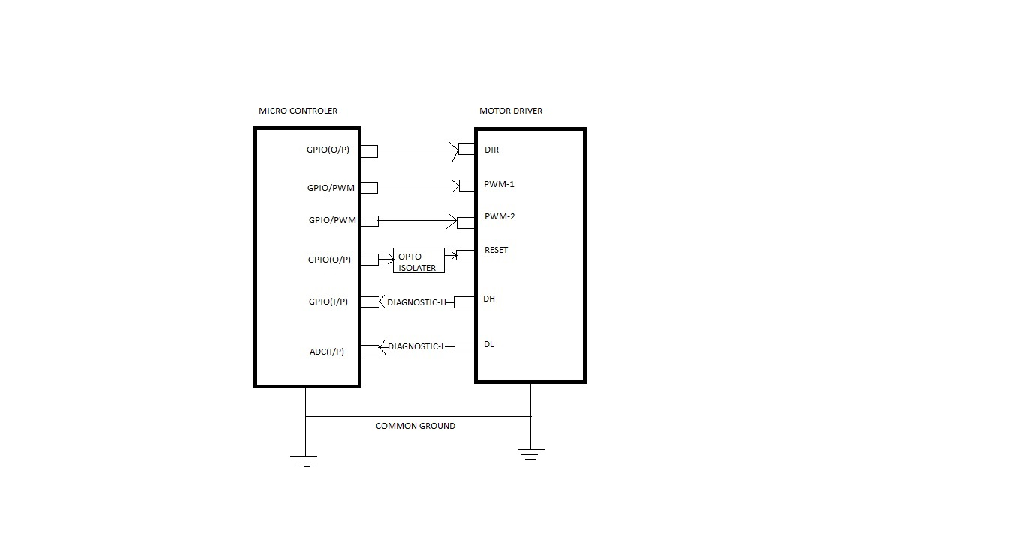
INTERFACING MOTOR DRIVER WITH MICRO- CONTROLLER

Slide 20
Analysis 1:
Motor: DC Brushless Hub Motor, 200 Rpm, 150 Kg-cm Torque, 24 Volts, 60 Amperes
Battery: Lithium Ion, 2000 mAH, 20Coulombs (20*2 = 40Amps)
Max Speed: 16Km/hour (Can be increased to 20Km/hour)
Distance: 9.5 Kilometers
Range in Time: 50 min
Charging Time: 1.5 Hours
Analysis 2:
Motor: DC Brushless Hub Motor, 200 Rpm, 150 Kg-cm Torque, 24 Volts, 60 Amperes
Battery: Lithium Ion, 3000 mAH, 20Coulombs (20*3 = 60Amps)
Max Speed: 16Km/hour (Can be increased to 20Km/hour)
Distance: 12.8 Kilometers
Range in Time: 70 min
Charging Time: 1.5 Hours

Slide 21
Analysis 3:
Motor: DC Brushless Hub Motor, 200 Rpm, 150 Kg-cm Torque, 24 Volts, 60 Amperes
Battery: Lithium Ion, 4000 mAH, 20Coulombs (20*4 = 80Amps)
Max Speed: 16Km/hour (Can be increased to 20Km/hour)
Distance: 16.1 Kilometers
Range in Time: 90 min
Charging Time: 1.5 Hours

Slide 22
Key Design Features
Remote Free [ Controllable via Smart Phones if needed]
Strap In And Control Design
Control Action
Walkability(Yet to be improved)
Useful For the Physically challenged to move at their ease
Good Aid for the Elder People
Compact and reasonable weight
Proper vent System for making it stay cool
Aesthetic Design and Trendy

Slide 23
SOCIAL IMPACT
Will help the physically challenged to move around with no or little restriction for the space that is usual for common persons.
Can make them move in a life size and reach out more objects like common beings as they are able to stand on with the feet.
Old People, who are weak to walk, can also make use of this boot to reach out more.
Can be used in Emergency situations/ for leisure with a little tune up.
To move around in hospitals for doctors, Nurses etc.,

Slide 24
ESTIMATED COST
The following cost will include the cost for the parts aforementioned and for the following tests:
Motor Vibration, Speed, Torque Analysis
Motor Noise reduction and stability analysis
3D Printing of some parts for prototype testing
And further improvements in the design
Final cost: Rs. 70,000/- (Approx)

Slide 25
FUTURE ADVANCEMENT
Make it available for wide variety of disabled people at very affordable costs(around Rs.12,000 to Rs.15,000 or even less) on further improvement on design and parts
Make it controllable through the use of Smartphone enabled with GPS for routing the boot to the destined place
Make it voice controlled and interactive like ‘Ok Google’

