Slide 1

National Institute of Technology, Uttarakhand Department of Electrical Engineering
Bidirectional Energy Meter with APFC
Project by:-
Ritik Singh
Bhumika Meena
Anuj Kumar
Junaid Alam
Guided By:-
Mr. Himesh Kumar

Slide 2
Content
Introduction
Features:
  Bi-directional Metering
  APFC
  Smart Metering

Slide 3
Introduction
Present system consume more time.
Traditional billing system inaccurate.
Provides Real time monitoring.
Visibility
Accurate billing
Efficient power management.

Slide 4
Features
This project is a combination of Bi-directional metering, Automatic Power Factor Correction unit & Smart Metering.
Bi-directional metering:-
Bidirectional meter measures power flows going into & out of our home or business.
Automatic Power Factor Correction unit:-
Smart metering
As it is conneted to internet so our data updates in real time. It fetch the Price from “VidyutPravah.in” and upload the power data to Thinkspeak and deliver message to customer mobile number.

Slide 5
Bidirectional Net Meter
Bidirectional meter measures power flows going into & out of our home or business.
Allows businesses and individuals generating their own electricity to deliver unused energy back to their local power grid
Bidirectional meter has three different readings:
Delivered: power flow going into the home.
Received: power flow coming out of the home.
Net: difference between delivered and received.

Slide 6
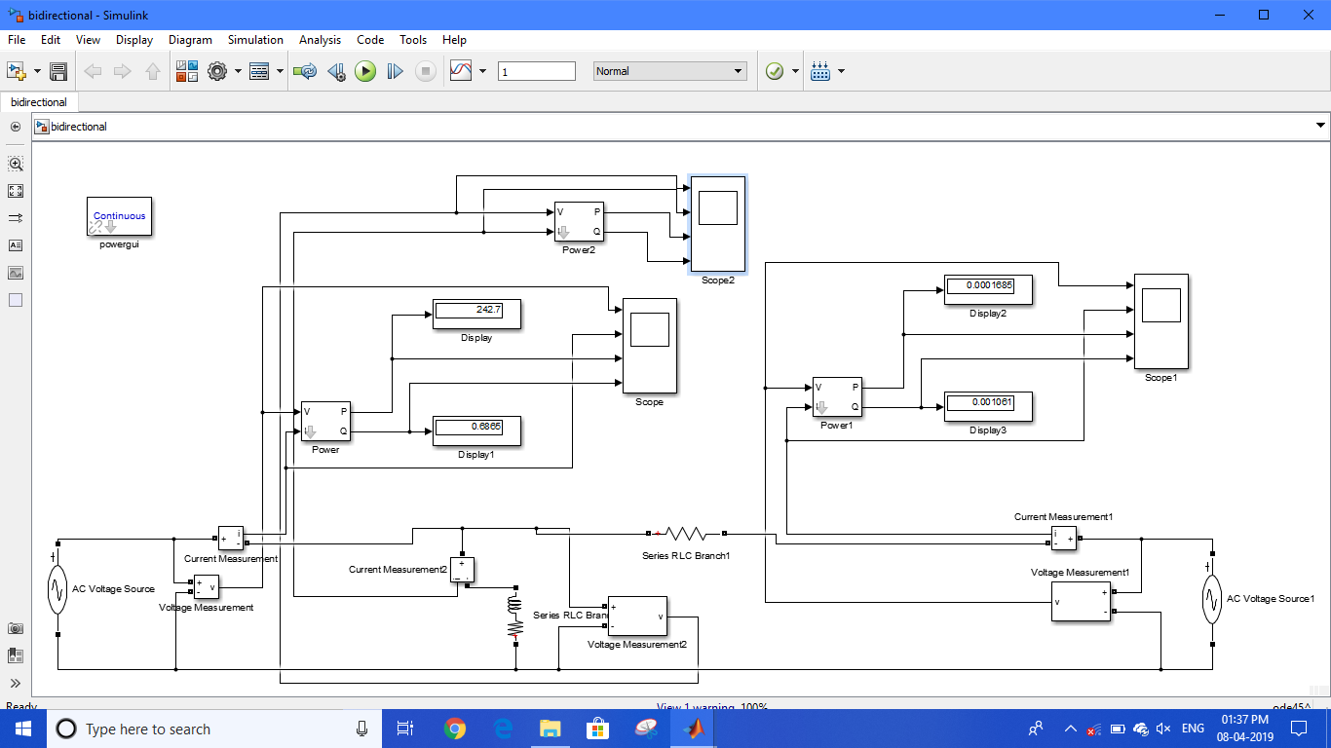
MATLAB SIMULATION ON BIDIRECTIONAL POWER FLOW

Slide 7
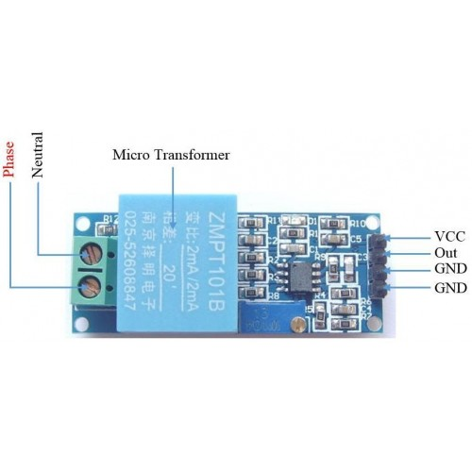
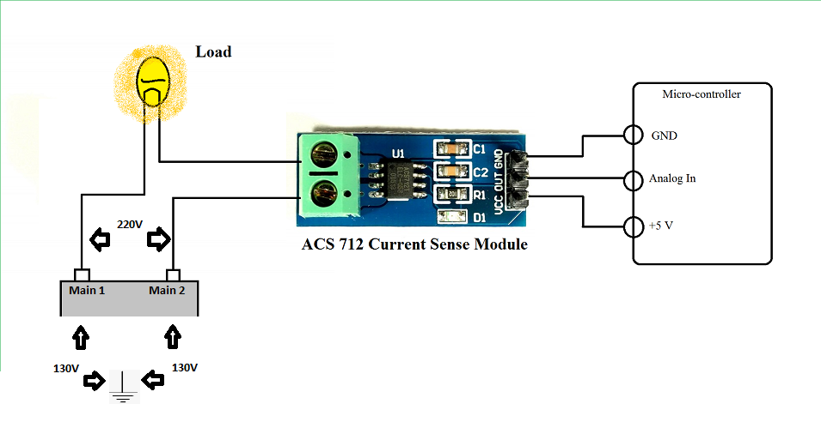
Voltage Sensor (ZMPT101B) & Current Sensor (ACS712)

Slide 8
Benefits of Bidirectional Net Meter
benefit of net metering is that it can help reduce your yearly spending on electricity.
Helping to reduce demand on the grid, especially during peak consumption periods.
Encouraging active participation in alternative energy production.

Slide 9
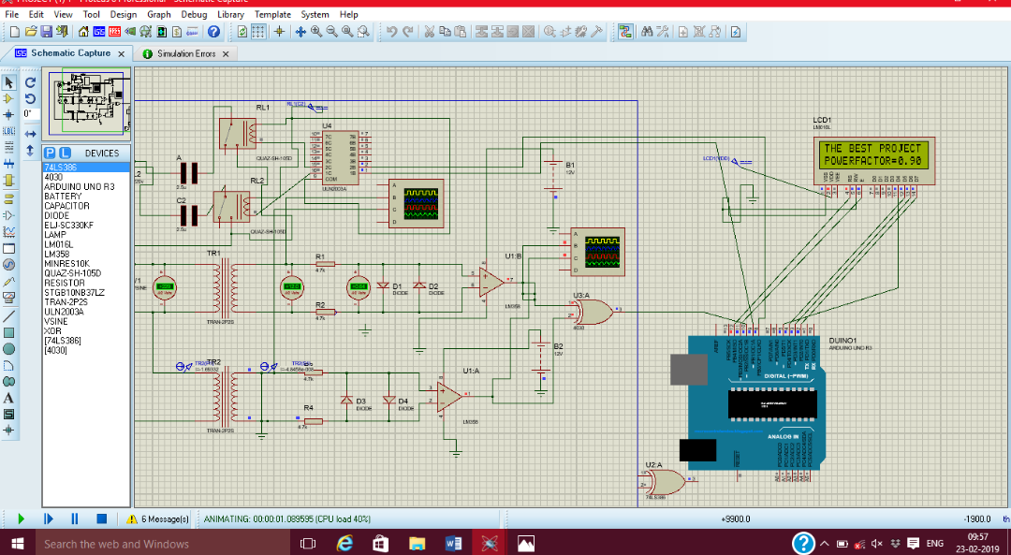
APFC
Power Factor Measurement

Slide 10
Smart Meter
Introduction:-
As it is conneted to internet so our data updates in real time.
Its contain two parts:-
Fetching live data from the internet.
Uploading the data from our project to internet.

Slide 11
Fetching of data from internet
Our Wi-Fi module is connectd to internet through mobile hotspot or can be connected to any near by available Wi-Fi.
It connects to the API of site “VidyutPravah.in” for fetching the live price data and update itself after every 15 minutes .
The price value is passed to Arduino Mega through Serial Communication between Arduino Mega and Wi-fi module.
Energy cost is calculated by using the energy consumed by load and price data fetched by Wi-Fi Module.

Slide 12
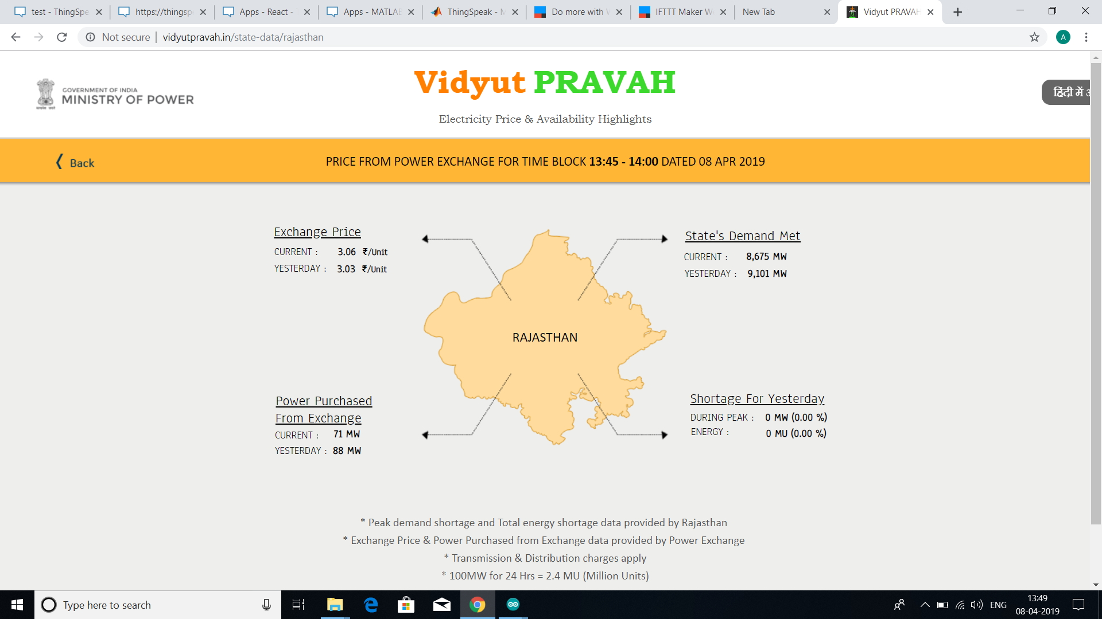

Slide 13
Uploading data to internet.
Data servers of Thingspeak is used .
Power data from Arduino Mega is passed to Wi-fi module through serial communication.
The power Data is then uploaded to Thingspeak in real time .
A message is delivered to the customer if they consume more reactive power even after they have fully utilized the capacitors and power factor is not becoming unity.

Slide 14
