Slide 1
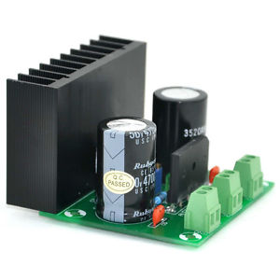
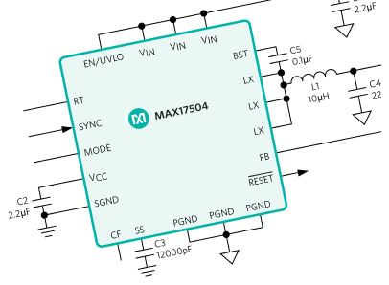
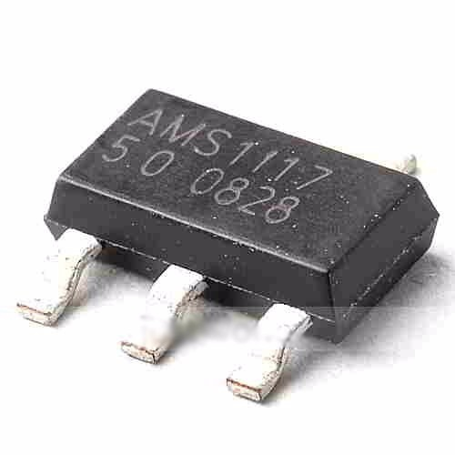
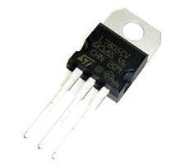
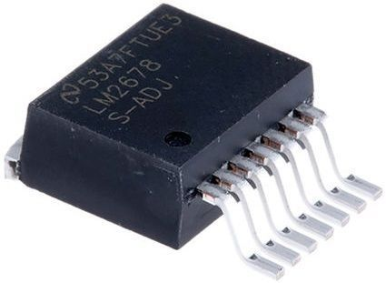
VEGEtek - 004
Linear and switching voltage regulators
Hossam “VEGETA” Moghrabi

Slide 2
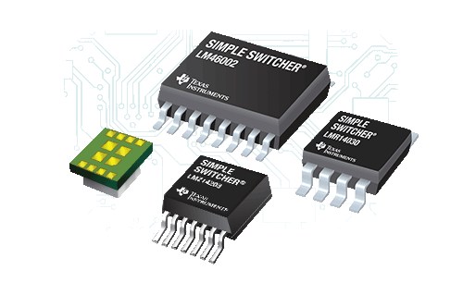
Voltage regulators
A voltage regulator is a device, IC, or circuit that outputs a fixed voltage to it’s loads. For example, a 5v regulator outputs 5v to the loads which can be 100 Ohms which will result in 50mA of current. Each regulator has its own limitation in terms of current and total power.
Types of voltage regulators
Basically 2 main types: linear and switching. Each of them has its own advantages and disadvantages, as well as, field of application.
Both types has an electronic switch (transistor) as well as other elements. The main difference is the utilization of this transistor element in each topology.

Slide 3
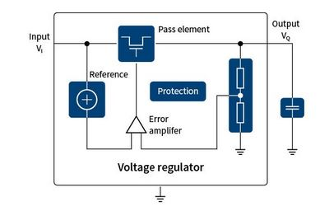
Linear regulator
Figure 1 shows the typical linear regulator, the transistor here is called “pass element” which is delivering power continuously to the load.
The transistor here can be BJT or MOSFET and it will be operating in the “linear region”.
A feedback signal and a reference signal is compared together using an error amplifier (Op-amp), which in turns controls the transistor to keep it’s output voltage stable.
Figure 1: linear voltage regulator basic schematic

Slide 4
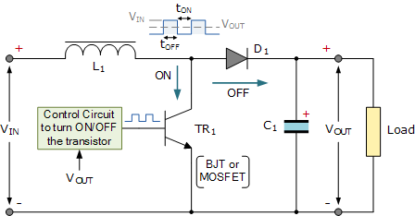
Switching regulator
Figure 2 shows the typical switching regulator, the transistor here is called “switching element” which is connecting and disconnecting input power to the load.
The transistor here can be BJT or MOSFET and it will be operating in the “saturation” or “cut off” region.
Switching regulators have an energy storage element to store energy and discharge it continuously. Thus power is in a form of pulses in the transistor not a continuous flow of current.
Figure 2: switching voltage regulator (boost) schematic

Slide 5
Comparison between linear and switching regulators
Criteria | linear regulator | Switching regulator
Design complexity | Low | Mid to high
Efficiency | Low and thus big heat dissipation | High
Cost | Low | Higher than linear
Size | Small | Big with much more components
Noise | Low | High due to switching effect
Range conversion | Only step-down | Step up, down, and inverting
Isolation | No | Yes
Dropout voltage: it is the voltage difference between input and output voltage. It is what determines the efficiency of the linear regulator. LDOs are low dropout regulators which operates at a very low dropout such as 1v.
Example: input voltage = 10v, output voltage = 7v, and 1A of current will have 3v dropout (10-7). Thus the wasted power in the transistor of the linear regulator is 3v * 1A = 3W which is too much. Efficiency is 7W/10W = 0.7 = 70%, while similar switching regulator of the same specs can easily reach 95%. Many linear regulators do not have such low dropout like regulating 12v to 5v (at 2A) which has ~ 41.7% efficiency. Heatsinks are a must in most linear regulators.

Slide 6
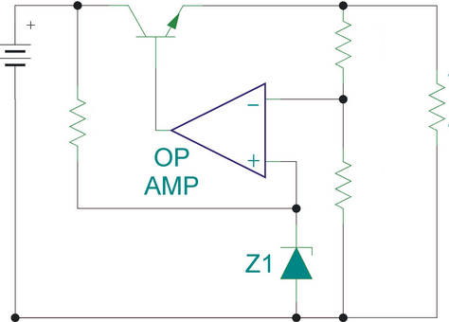
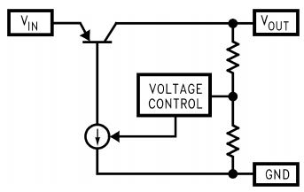
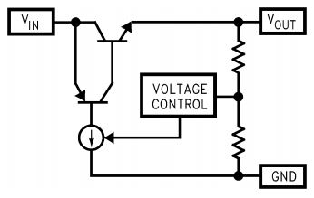
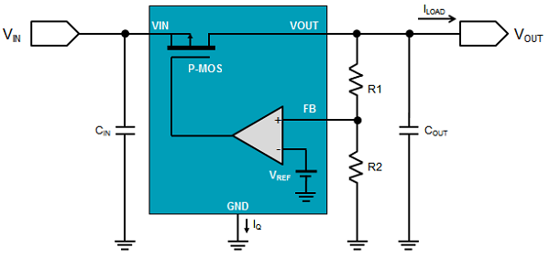
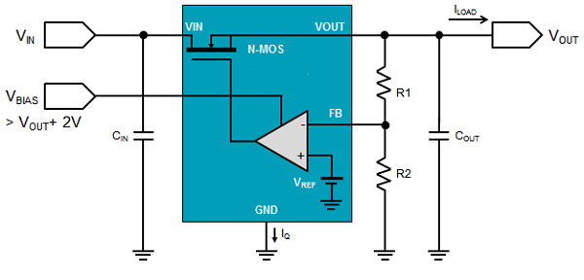
Types of linear regulators
Depends on the pass element used, which determines the dropout voltage and stability.
NPN (and Darlington NPN)
PNP (LDO regulator)
Quasi regulator
P-MOSFET regulator
N-MOSFET regulator

Slide 7
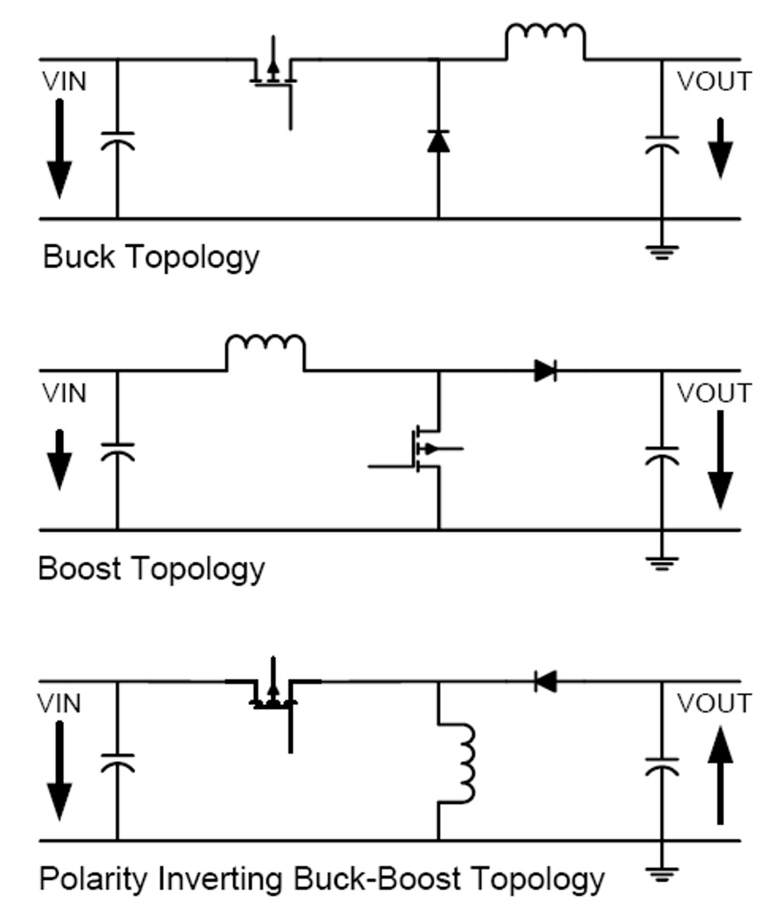
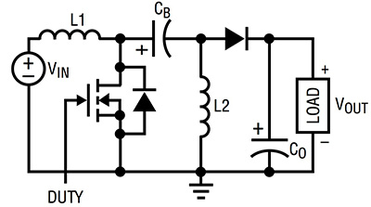
Types of switching regulators
Depends on the arrangement of the elements in the circuit and control signals.
SEPIC topology
There are other topologies like fly-back (which offers isolation), Cuk, forward, push-pull,… etc.

Slide 8
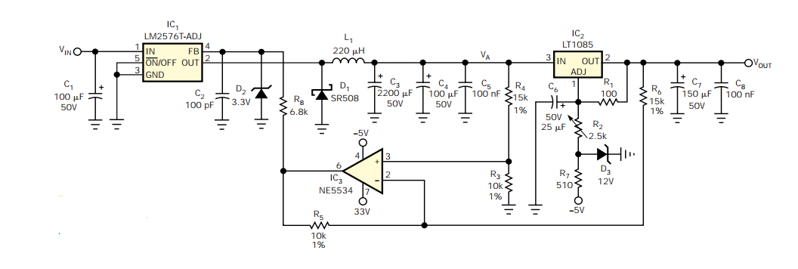
Hybrid regulators
These are circuits which combines both switching and linear regulators. Linear regulator is the final output regulator while the switching one is before it so that the switching one provides the linear one with an input of the output voltage + a small dropout to enhance efficiency while keeping the useful and clean linear regulator output.
Such switching regulators are called “Pre-regulators” and the linear regulators are sometimes called “Post-regulators”. It is a relatively new method in power supplies to gain high efficiency and low dropout at the same time. The pre-regulators might be controlled by a feedback from the linear output voltage, in this case the switching regulator is called “tracking pre-regulator”. Figure 2 below shows an example of the hybrid regulator.
Figure 2: hybrid regulator

