Slide 1
OBJECTIVE AND FEATURES:
The project is a security system which allows only authorized access to users with a password.
The system has a feature of changing the password anytime by the authorized user as required.
The project comprises of a microcontroller of PIC family that is interfaced to an EEPROM which stores the password.
The project requires a keypad to enter password, and a Motor Driver that is interfaced to microcontroller for locking or unlocking a door or any security system.
An alert would be produced if there is any wrong attempt and a door open if the attempt is right. The project can be used for security purposes in home, offices, organizations etc.

Slide 2
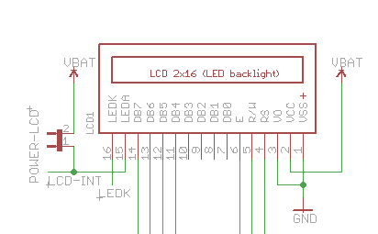
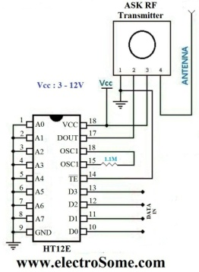
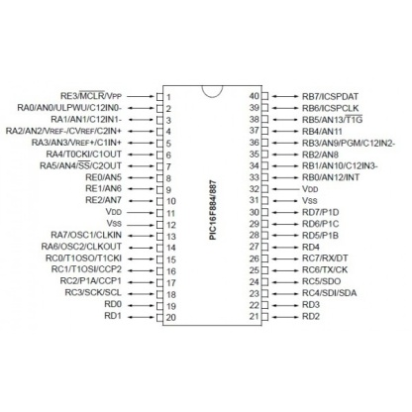
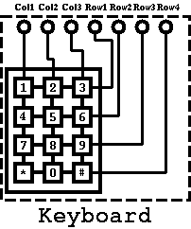
BLOCK DIAGRAM
LCD display the information send by user using keypad
Converts parallel data to series
HT12E
If the password send by the user is correct, then it proceeds further information to encoder IC
Keypad sends data to microcontroller

Slide 3
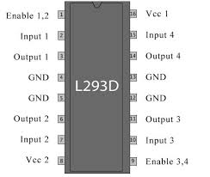
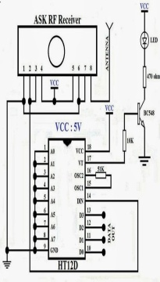

Block diagram part 2
Controls Locking and unlocking of security system
MOTOR DRIVER IC
RF Transmitter
And HT12E
RF Receiver and
HT12D

Slide 4
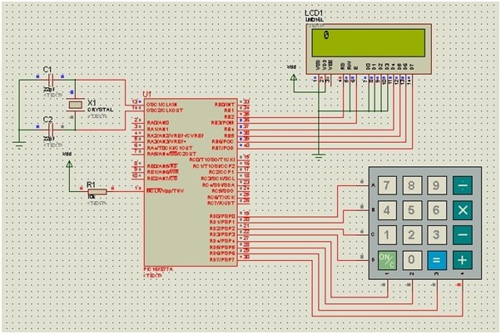
WORKING OF EACH BLOCK DIAGRAM: PIC MICROCONTROLLER INTERFACES WITH LCD AND KEYPAD MATRIX:

Slide 5
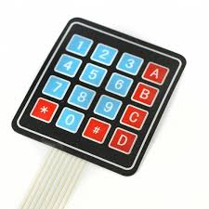
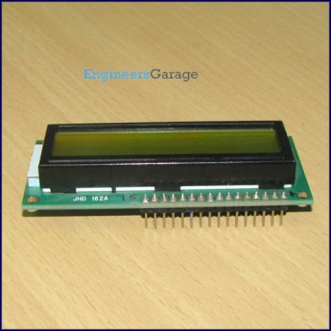
Keypads have been used extensively in automotive applications as well as food industries. Programmed Keypads can be used in automated attendance system at schools, offices etc, where you enter your ID, which is displayed and at the same time stored, to mark your presence. Automatic door locks are usually accessed with a keypad control system in which a particular code is dialed on the keypad to open the door.
LCD (Liquid Crystal Display) screen is an electronic display module and find a wide range of applications. A 16x2 LCD display is very basic module and is very commonly used in various devices and circuits. These modules are preferred over seven segments and other multi segment LEDs. The reasons being: LCDs are economical; easily programmable; have no limitation of displaying special & even (unlike in seven segments), animations and so on.

Slide 6
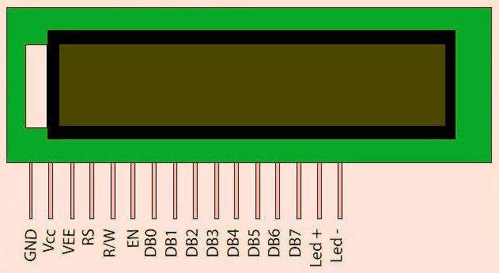
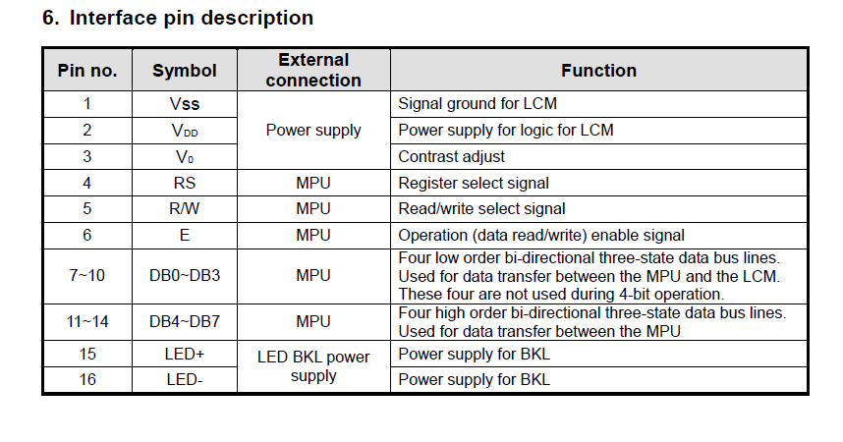
PIN DIAGRAM OF LCD 16*2
RS pin:
0:command
1: data
vo:
variable voltage
Adjust contrast light

Slide 7
WORKING OF HT12E AND HT12D: What is Encoding and Decoding:
In simple words, encoding is wrapping up the data.
The data could be anything like simple binary data (in the form of 1's and 0's) or it could be an audio signal or it could be certain text.
The wrapped data is called as a Packet. This packet is sent through a medium (“Through wire or wireless”) to the decoder part where it gets unwrapped or decoded. Encoding is when you put the letter into envelope, the postman is medium to take the envelope to the recipient and when recipient opens the envelope then it is called decoding.

Slide 8
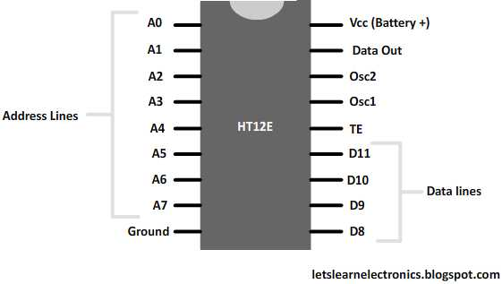
HT12E (Transmitter side)
The encoder has four input lines.
These lines are used to give input which we want to encode.
In encoding, we are wrapping up the data which means if we want to send a binary signal ‘1001’ to other end, we have to make data pins as ‘1001’.
Now, to make data pin like this, what we need to do is to give high or 5 volts (which in digital means ‘1’) to pins ‘D0’ and ‘D3’ while we have to provide pins ‘D1’ and ‘D2’ with 0 volt. Ground).
This altogether gives us ‘1001’ which is transmitted out from the ‘Data out’ pin of the HT12E.
The input given to data pin is in parallel form which is being transmitted into serial form from the data output pin.

Slide 9
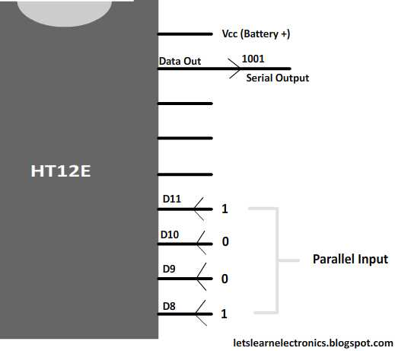
PIN 17 is used as DOUT pin.
It follows serial communication.
Now neglect all the pins for this moment and just concentrate on Din (Data in) pin and the for Data lines pin.
The encoded data which is coming from the transmitter side goes into the Data in (Din) pin. The data which was in serial order gets decoded and the output is generated at the for data line pins in same order as that on transmitter pin.

Slide 10
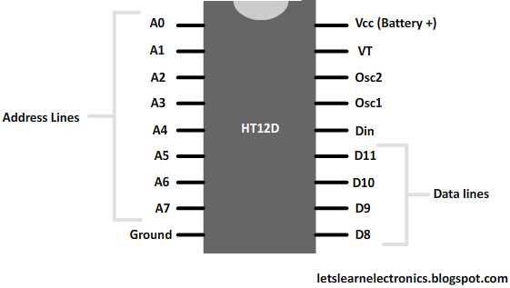
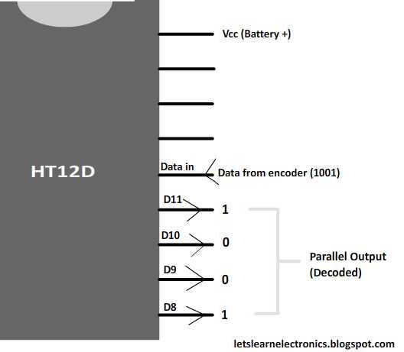
HT12D (Receiver side):
The data which was in serial order gets decoded and the output is generated at the for data line pins in same order as that on transmitter pin.

Slide 11
Oscillator Pins:
The role of oscillator in digital electronics is to produce waves which are in Sine wave form or rectangular wave form.
The device used to generate this waveform is called ‘Oscillator’. The waveform generated by the oscillator is called as ‘Pulses’ (like our heart beat).
So, in digital world the oscillator works identical to our Heart.

Slide 12
VT Pin (Valid Transmission):
The valid transmission pin in decoder shows that the transmitter address and the receiver address are same and is ready to receive the data from the encoder side.
VT PIN:
VALID TRANSMISSION

Slide 13
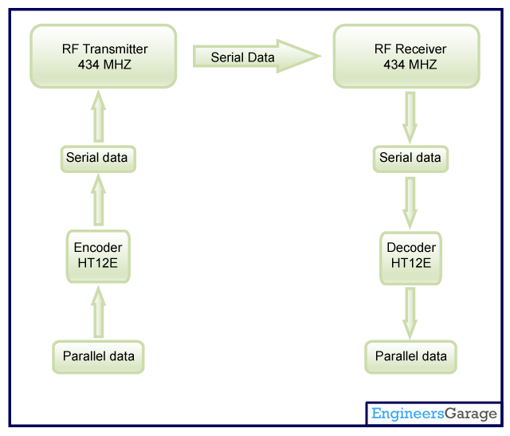
WORKING BLOCK OF HT12E AND HT12D:

Slide 14
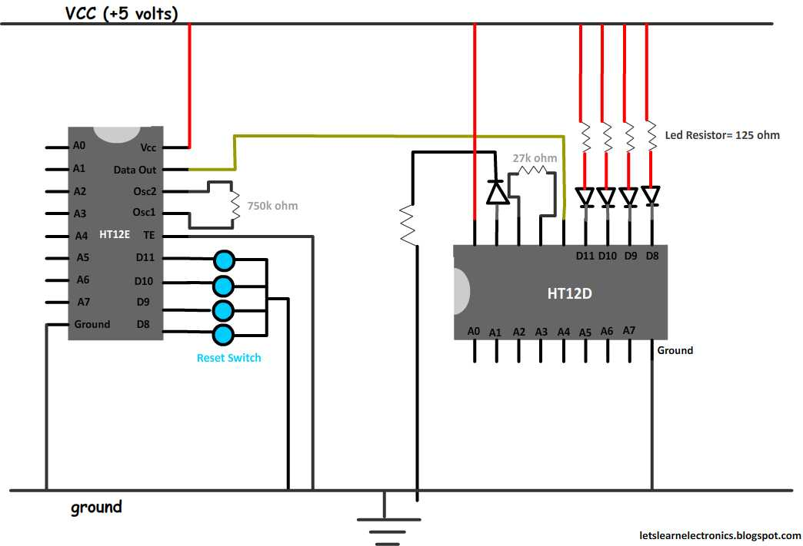
WIRED DATA TRANSMISSION

Slide 15
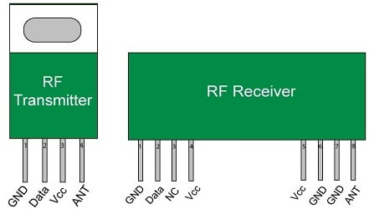
WIRELESS DATA TRANSMISSION RF TRANSMITTER AND RECEIVER
A wireless radio frequency (RF) transmitter and receiver can be easily made using HT12D Decoder, HT12E Encoder and ASK RF Module.
Wireless transmission can be done by using 433 MHz or 315MHz ASK RF Transmitter and Receiver modules. In these modules digital data is represented by different amplitudes of the carrier wave, hence this modulation is known as Amplitude Shift Keying (ASK). Radio Frequency (RF) transmission is more strong and reliable than Infrared (IR) transmission due to following reasons :
Radio Frequency signals can travel longer distances than Infrared.
Only line of sight communication is possible through Infrared while radio frequency signals can be transmitted even when there are obstacles.
Infrared signals will get interfered by other IR sources but signals on one frequency band in RF will not interfered by other frequency RF signals.

Slide 16
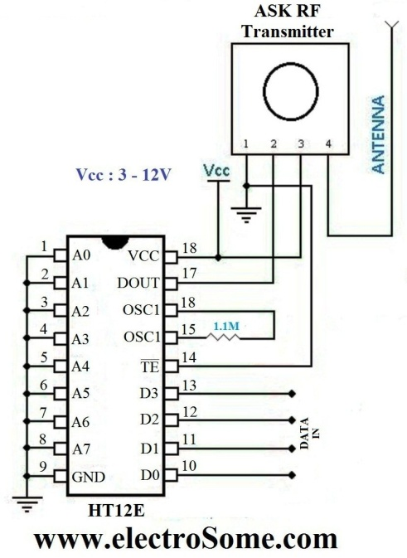
Transmitter Circuit Diagram
HT12E Encoder IC will convert the 4 bit parallel data given to pins D0 – D3 to serial data and will be available at DOUT. This output serial data is given to ASK RF Transmitter.
Address inputs A0 – A7 can be used to provide data security and can be connected to GND (Logic ZERO) or left open (Logic ONE).
Status of these Address pins should match with status of address pins in the receiver for the transmission of the data. Data will be transmitted only when the Transmit Enable pin (TE) is LOW. 1.1MΩ resistor will provide the necessary external resistance for the operation of the internal oscillator of HT12E.

Slide 17
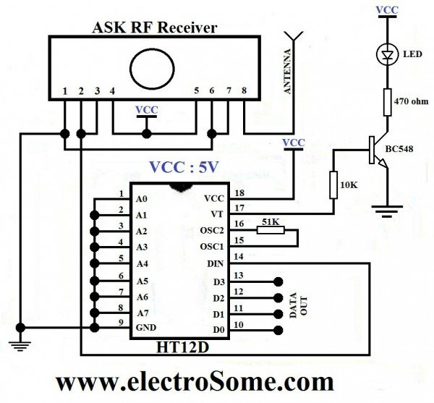
Receiver Circuit Diagram
ASK RF Receiver receives the data transmitted using ASK RF Transmitter. HT12D decoder will convert the received serial data to 4 bit parallel data D0 – D3.
The status of these address pins A0-A7 should match with status of address pin in the HT12E at the transmitter for the transmission of data.
The LED connected to the above circuit glows when valid data transmission occurs from transmitter to receiver. 51KΩ resistor will provide the necessary resistance required for the internal oscillator of the HT12D.

Slide 18
THANK YOU
NAME:VIKRANT THAKUR
CLASS:EEE,3rd YEAR,
COLLEGE:MSIT

